Slide 1

Thermal and Radioactive Pollution and AI Assessment
Information Security Fundamentals | Environmental Pollution and Remediation
Course: Information Security Fundamentals | Chapter: Environmental Pollution and Remediation | Program: Bachelor of Engineering
DISCOVER · LEARN · EMPOWER
Notes:
Welcome everyone to today's lecture on Environmental Pollution and Remediation. We will focus specifically on the critical threats of thermal and radioactive pollution. You will also learn how modern AI tools are revolutionizing the assessment of these risks. Let us begin our journey to understand and mitigate these ecological challenges.

Slide 2
Course Outcomes
SLIDE 2 / 14
Course Outcome
CO | BT LEVEL | DESCRIPTION
CO1 | BT4 | Recall, analyze and respond on fundamental environmental principles, such as ecological relationships and conservation strategies
CO2 | BT4 | Understand and analyze the interconnections between human activities and environmental impacts across different ecosystems
CO3 | BT4 | Understand and analyze and apply environmental laws and policies to analyse and propose solutions for real-world environmental challenges.
CO4 | BT2 | Students will analyse data from environmental monitoring programs to assess trends and predict future impacts on ecosystems.
CO5 | BT6 | Interpret, elaborate and propose various tools, design and innovative strategies for sustainable development and environmental conservation initiatives in securing the planet.
Chandigarh University
2 / 14
Notes:
Today's lecture is directly mapped to Course Outcome 2. This outcome requires you to analyze how human industrial activities create specific environmental impacts. We will see how thermal discharges and radioactive leaks are direct consequences of these activities. Our goal is to understand the cause-and-effect relationship in different ecosystems.

Slide 3
Learning Objectives
SLIDE 3 / 14
Learning Outcomes
1
Analyze the mechanisms of thermal pollution and its impact on aquatic life.
2
Evaluate the health risks associated with exposure to radioactive pollutants.
3
Assess risk factors for various environmental pollutants using quantitative methods.
4
Predict ecological impacts of pollutants using AI-powered predictive modeling tools.
5
Differentiate between acute and chronic exposure risks in human populations.
Chandigarh University
3 / 14
Notes:
By the end of this session, you will be able to analyze how thermal pollution disrupts aquatic ecosystems. You will evaluate specific health risks from radioactive materials like radon and isotopes. We will also assess risk factors using quantitative methods and predict impacts using AI. Finally, you will differentiate between acute and chronic exposure scenarios.

Slide 4
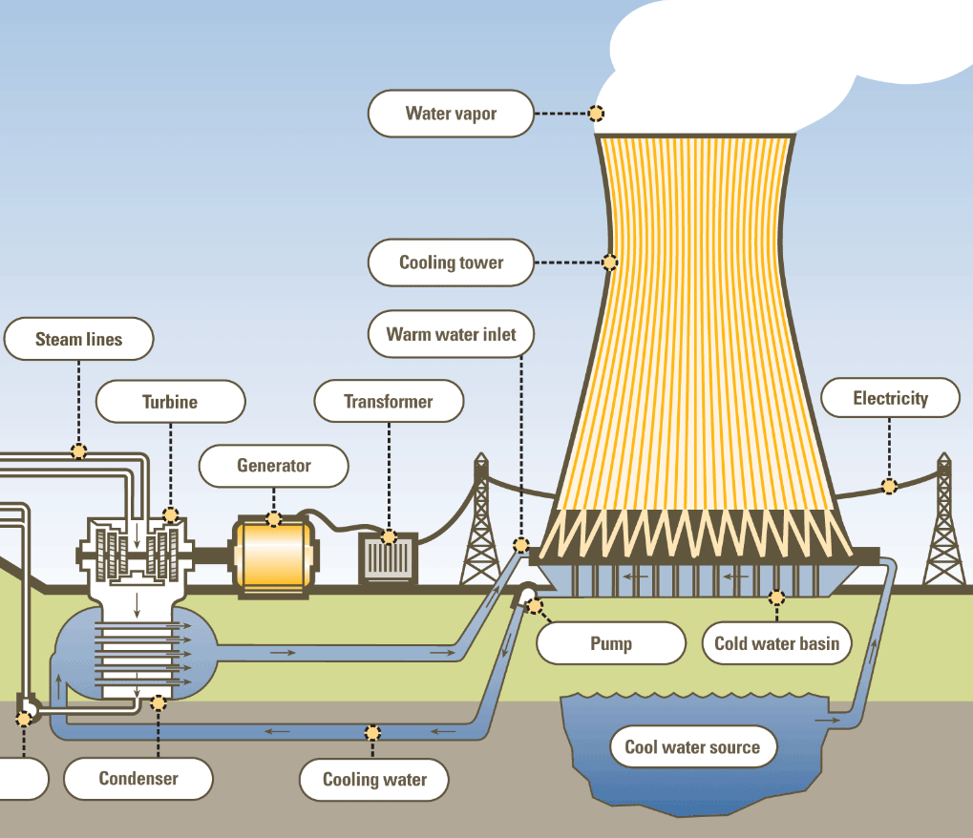
Thermal Pollution
SLIDE 4 / 14
Definition and Sources
1
Thermal pollution is the degradation of water quality by any process that changes ambient water temperature.
2
Primary sources include power plants, industrial cooling systems, and urban runoff from paved surfaces.
3
Discharged water often exceeds natural temperatures by 10°C to 15°C above ambient levels.
4
Elevated temperatures reduce dissolved oxygen levels, threatening aquatic organism survival rates.
5
Thermal shock can cause immediate mortality in fish and invertebrate populations.
6
Industrial effluents often carry heat alongside chemical contaminants, compounding the damage.
Cooling Towers - Dry, Wet - Natural draught | nuclear-power.com
Chandigarh University
4 / 14
Notes:
Thermal pollution is not just about heat; it is a degradation of water quality. Power plants are the biggest culprits, often discharging water 10 to 15 degrees Celsius hotter than the river. This heat reduces dissolved oxygen, which is critical for fish survival. Imagine a fish gasping for air in water that has lost its oxygen due to heat.

Slide 5
Lecture
SLIDE 5 / 14
Impact of Thermal Pollution on Ecosystems
1
Higher temperatures increase metabolic rates, leading to higher oxygen consumption by aquatic life.
2
Reduced dissolved oxygen creates hypoxic zones where fish cannot survive or reproduce.
3
Thermal stratification prevents mixing, trapping pollutants at the bottom of water bodies.
4
Sensitive species like trout and salmon are displaced by heat-tolerant invasive species.
5
Reproductive cycles of fish are disrupted, leading to population declines over time.
6
Algal blooms often follow thermal spikes, further depleting oxygen during decomposition.
Chandigarh University
5 / 14
Notes:
When water gets hotter, fish metabolism speeds up, meaning they need more oxygen. However, hot water holds less oxygen, creating a deadly paradox. This leads to hypoxic zones where fish suffocate. You might see trout disappearing while invasive carp thrive in the warmer conditions.

Slide 6
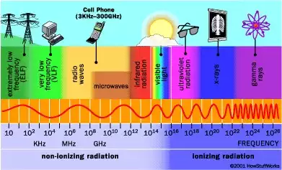
Radioactive Pollution
SLIDE 6 / 14
Sources and Types
1
Radioactive pollution arises from nuclear power plants, mining, and medical waste disposal.
2
Common pollutants include isotopes like Iodine-131, Cesium-137, and Strontium-90.
3
Accidental leaks from reactors or improper waste storage are major contamination sources.
4
Radioactive particles can contaminate soil, groundwater, and the food chain.
5
Background radiation levels increase significantly in areas near nuclear facilities.
6
Long-lived isotopes remain hazardous for decades or even centuries after release.
Radiation and Nuclear Health Hazards (source: cdn.serc.carleton.edu)
Chandigarh University
6 / 14
Notes:
Radioactive pollution comes from nuclear power, mining, and medical waste. Isotopes like Iodine-131 and Cesium-137 are particularly dangerous. These particles can seep into groundwater and enter the food chain. Even small leaks can create long-term hazards that last for decades.

Slide 7
Lecture
SLIDE 7 / 14
Health Impacts of Radioactive Exposure
1
Acute exposure causes radiation sickness with symptoms like nausea and skin burns.
2
Chronic low-level exposure increases the risk of cancer and genetic mutations.
3
Thyroid cancer is a specific risk from Iodine-131 accumulation in the body.
4
Bone marrow damage leads to reduced blood cell production and immune failure.
5
Fetal exposure can cause developmental defects and childhood leukemia.
6
Cumulative dose determines the severity of long-term health consequences.
Chandigarh University
7 / 14
Notes:
Exposure to radiation can cause immediate sickness or long-term cancer. The thyroid is highly sensitive to Iodine-131, often leading to cancer. Bone marrow damage reduces blood cells, weakening the immune system. Fetal exposure is particularly dangerous, causing developmental issues and leukemia in children.

Slide 8
Lecture
SLIDE 8 / 14
Assessment of Pollutant Risk Factors
1
Risk assessment involves identifying hazards and estimating the probability of harm.
2
Key factors include concentration, duration of exposure, and toxicity of the pollutant.
3
Bioaccumulation factors measure how pollutants concentrate in organisms over time.
4
Exposure pathways include inhalation, ingestion, and direct skin contact with contaminated soil.
5
Vulnerable populations like children and the elderly face higher relative risks.
6
Regulatory limits define safe thresholds for various pollutants in air and water.
Radiation and Nuclear Health Hazards (source: cdn.serc.carleton.edu)
Chandigarh University
8 / 14
Notes:
Risk assessment is about identifying hazards and estimating harm probability. We look at concentration, exposure duration, and toxicity. Bioaccumulation is crucial; it shows how pollutants build up in organisms. Children and the elderly are often the most vulnerable to these risks.

Slide 9
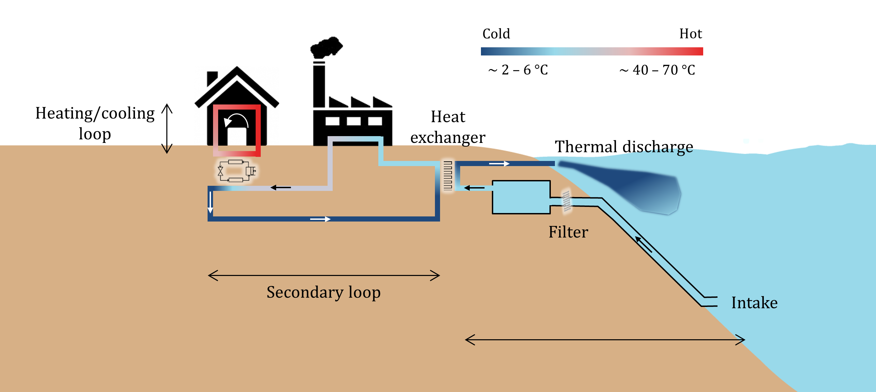
Worked Example
SLIDE 9 / 14
Thermal Load Calculation
GOVERNING EQUATION
Calculate heat load: Q = m × c × ΔT
m is mass flow rate.
EXAMPLE
500 kg/s of water heated from 20°C to 35°C.
CALCULATION
Q = 500 × 4186 × (35 - 20) = 31,395,000 Joules/second.
• Specific heat of water (c) is approximately 4186 J/kg·°C.
• This equals 31.4 MW of thermal energy discharged into the river.
• Such a load can raise river temperature by 5°C in a small stream.
Source: thermdis.eawag.ch
Chandigarh University
9 / 14
Notes:
Let's calculate the thermal load. We use the formula Q equals mass × specific heat × temperature change. For 500 kg/s of water heated from 20 to 35 degrees, the calculation yields 31.4 megawatts. This massive heat discharge can raise a small river's temperature by 5 degrees, killing fish.

Slide 10
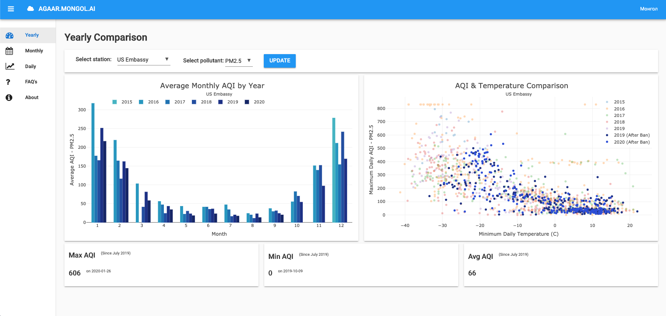
Lecture
SLIDE 10 / 14
AI Tools for Ecological Impact Prediction
1
Machine learning models predict pollutant dispersion patterns in water and air.
2
Neural networks analyze historical data to forecast future contamination events.
3
AI algorithms process satellite imagery to detect thermal anomalies in real-time.
4
Predictive models simulate ecological recovery after remediation efforts are implemented.
5
Natural language processing extracts risk data from thousands of environmental reports.
6
AI reduces prediction errors compared to traditional linear statistical methods.
Source: anvil.works
Chandigarh University
10 / 14
Notes:
AI is changing how we predict pollution. Machine learning models can forecast dispersion patterns in water and air. Neural networks analyze historical data to predict future events. AI also processes satellite images to detect thermal anomalies instantly, offering real-time monitoring capabilities.

Slide 11
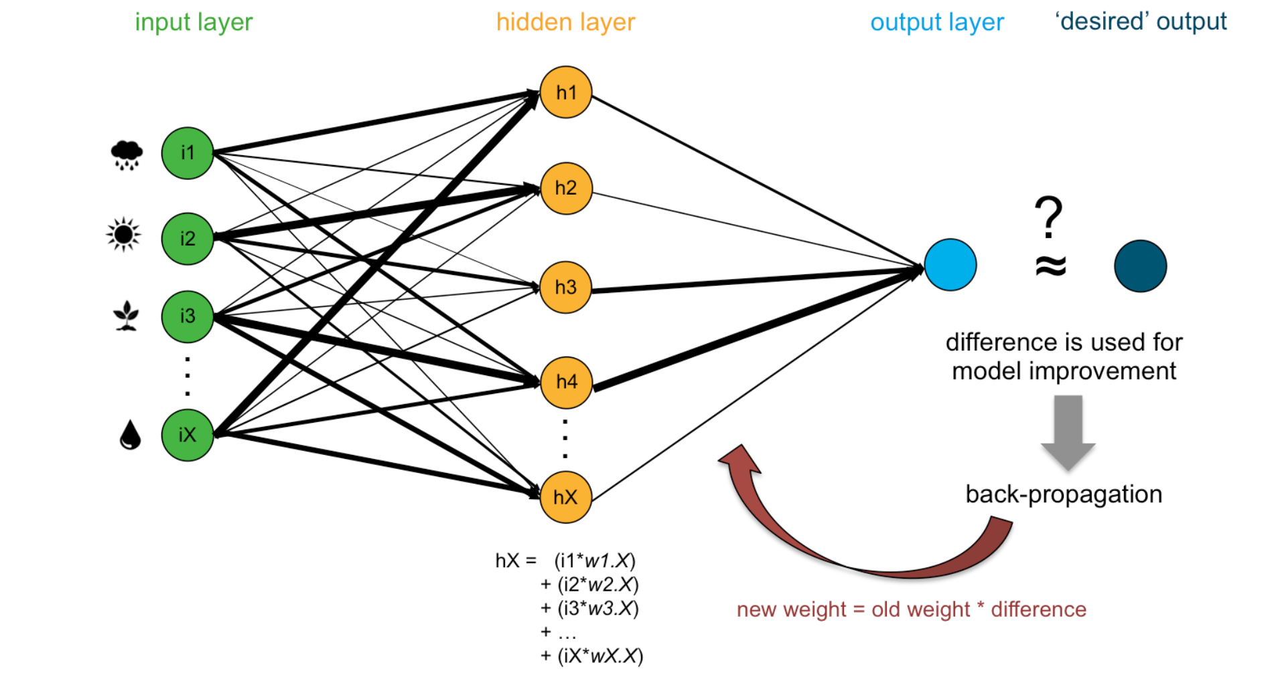
AI Techniques
SLIDE 11 / 14
Neural Networks and Regression
1
Artificial Neural Networks (ANN) mimic brain function to model complex pollution dynamics.
2
Regression analysis correlates pollutant levels with environmental variables like wind speed.
3
Deep learning models identify non-linear relationships in ecological datasets.
4
Time-series forecasting predicts seasonal variations in pollutant concentrations.
5
Clustering algorithms group similar pollution events for pattern recognition.
6
These tools handle large datasets that traditional methods cannot process efficiently.
Source: s3.amazonaws.com
Chandigarh University
11 / 14
Notes:
Neural networks mimic the brain to model complex pollution dynamics. Regression analysis helps correlate pollutant levels with variables like wind speed. Deep learning identifies non-linear relationships in data. These tools handle massive datasets that traditional methods simply cannot process efficiently.

Slide 12
Lecture
SLIDE 12 / 14
Common Pitfalls in Pollution Assessment
1
Ignoring cumulative effects of multiple pollutants acting synergistically on ecosystems.
2
Over-reliance on single-point measurements without considering spatial variability.
3
Failing to account for long-term bioaccumulation in the food chain.
4
Using outdated toxicity data that does not reflect current environmental conditions.
5
Neglecting the role of climate change in altering pollutant dispersion patterns.
6
Assuming linear relationships where non-linear dynamics actually exist.
Chandigarh University
12 / 14
Notes:
A common pitfall is ignoring cumulative effects where multiple pollutants act together. Over-reliance on single-point measurements misses spatial variability. We must also account for long-term bioaccumulation in the food chain. Using outdated toxicity data or assuming linear relationships can lead to dangerous underestimations.

Slide 13
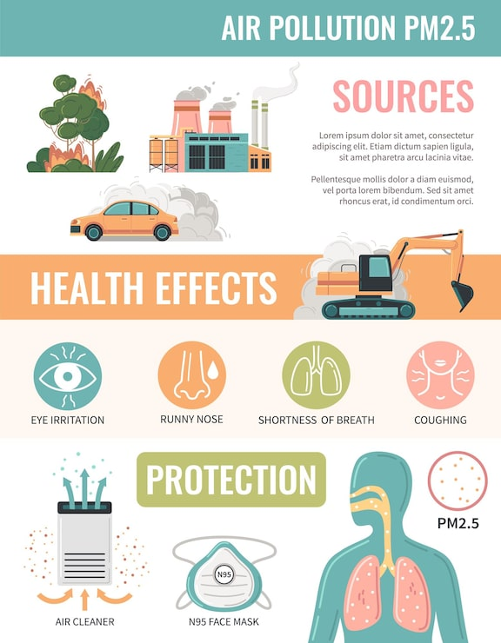
Lecture
SLIDE 13 / 14
Key Takeaways
1
Thermal pollution reduces dissolved oxygen, causing severe stress to aquatic life.
2
Radioactive pollutants pose acute and chronic health risks including cancer and mutations.
3
Risk assessment requires analyzing concentration, exposure duration, and bioaccumulation factors.
4
AI tools provide superior predictive capabilities for ecological impact modeling.
5
Accurate assessment avoids pitfalls like ignoring cumulative effects and spatial variability.
Source: img.magnific.com
Chandigarh University
13 / 14
Notes:
To summarize, thermal pollution reduces oxygen and harms aquatic life. Radioactive pollutants cause serious health risks like cancer. Risk assessment must consider concentration, duration, and bioaccumulation. AI tools offer superior prediction for ecological impacts. Finally, avoid pitfalls like ignoring cumulative effects.

Slide 14
Lecture
SLIDE 14 / 14
References
ENVIRONMENTAL STUDIES
From Crisis to Cure — R. Rajagopalan
• Environmental Science and Engineering — Benny Joseph
• Environmental Studies — R.C. Sharma and D. Gurbir Sangha
• Introduction to Environmental Science — Anjaneyulu, Y.
• Environmental Pollution Control Engineering — C.S. Rao
• Textbook of Environmental Studies for undergraduate courses — E. Bharucha
• Environmental Science — S.C. Santra
Chandigarh University
14 / 14
Notes:
These references provide the foundational knowledge for today's lecture. Benny Joseph and R.C. Sharma offer excellent insights into environmental engineering. Anjaneyulu and C.S. Rao cover pollution control in depth. Please consult these texts for further study on AI applications in environmental science.

